Slide 1
Development Sprint Process and
Tools Workflow Overview
December 20, 2012

Slide 2
Contents
Topic
Property PAS Sprint Process Overview
Development Sprint Cycle and Property PAS Teams 3
Primary Tools by Team 4
High Level Working Agreements (Deliverables and Hand-offs) 5
Pre-Sprint Activities that Occur Throughout Each Sprint (Product Backlog Refinement) 6
Sprint Planning Meeting and Subsequent Activities (Story Confirmation and Build Planning) 9
Daily Scrum Meeting and Daily Activities, Build Tracking and Defect Tracking 11
Sprint Review Meeting and Subsequent Activities 14
Sprint Retrospective Meeting and Subsequent Activities 15
Additional Process Considerations 16
Property PAS Tool Workflows
Business Requirement s Links in RRC 18
Status Flow: User Stories in RTC BSA Design Backlog 19
Status Flow: User Stories in RTC Product Backlog 20
Status Flow: Test Packages in RTC 21
Status Flow: Review Tasks in RTC 22
Status Flow: Implementation Tasks in RTC 23
Status Flow: Defects in QC and RTC 24
Standard RTC Queries 25
Tool Links 26
- 2 -

Slide 3
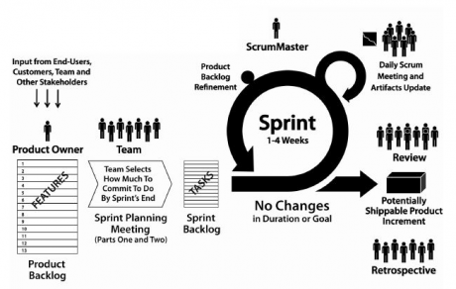
Dev Sprint Cycle and Property PAS Teams
Build Team
Test Execution Team
TA Team
Product Owners and Design Team
Test Automation Team
Defects Team
5 weeks
Business Review Team
Integrations Team
- 3 -

Slide 4
Primary Tools by Team
Build Team Maven
Test Execution and Automation Teams QC, QA Inspect, Load runner, QTP, Fortify
Product Owners, Design Team and Test Analyst Team
SharePoint
RRC – define
RTC – manage
Defects Team
QC
Scrum Team
RTC – manage tasks
SVN – source control
Java/J2EE – code
Liquibase – integration to DB
Oracle - database
VMware – manage dev env
Maven – build tool
Sonar – check code compliance
BR Team
Model Office, PAS
Integrations Informatica, Scripts
- 4 -

Slide 5
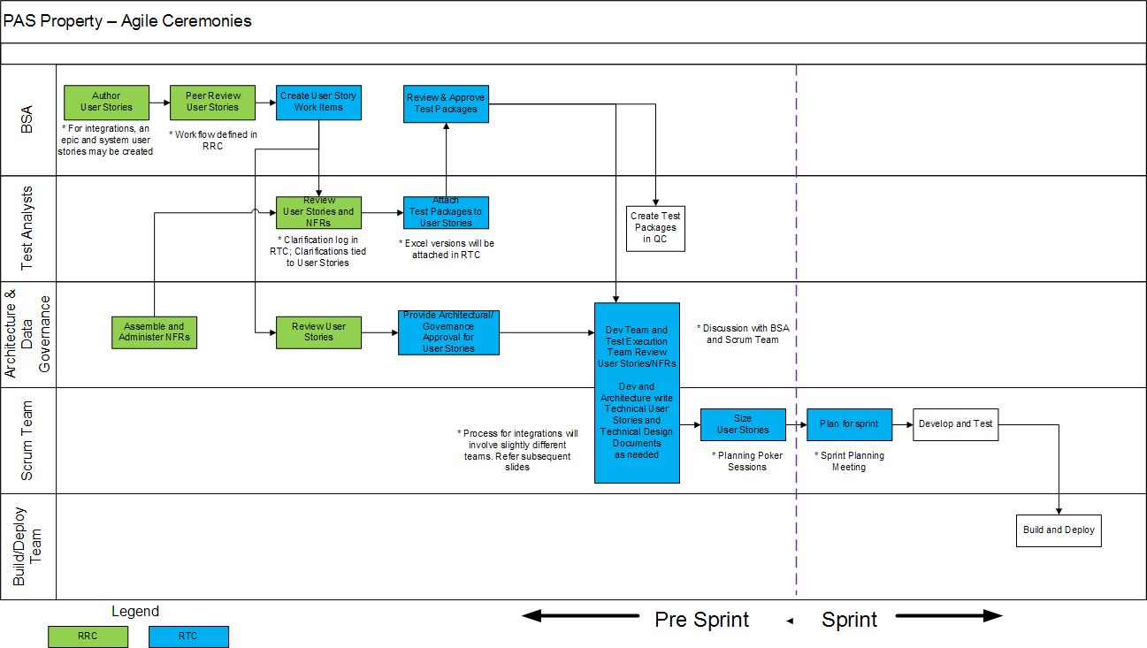
High Level Working Agreements – Deliverables and Hand-offs

Slide 6

Pre-Sprint Activities that Occur Throughout Each Sprint
Design (BSA) team creates user stories in RRC and updates statuses in the RTC Design Backlog
The BSA team moves internally reviewed stories to Product Backlog
Test Analysts create test packages for stories in the Product Backlog
Development scrum teams:
Review stories in the Product Backlog
Create implementation design artifacts
Fill out the Dev Review tab and link dependencies on the story
Architecture Team members review user stories once the Dev Review tab is complete
The integrations team develops integration specifications and designs
Architecture, Test and Dev teams review integration designs
SOA teams build services
DCS team builds forms
Stories are given baseline,
pre-poker and Planning
Poker estimations in story
points
- 6 -

Slide 7
More about Team and Dev Reviews
Once stories go into Team Review status, review tasks are created for the Dev Teams, Test Team and Architect
Tech Leads and Scrum Masters discuss story groupings and dependencies together before story selections for dev reviews commence
A team that does the dev review for a story is more likely to get to develop it, but there are no guarantees
Each team selects a set of stories for review that it thinks it can deliver quickly, including stories where it has special expertise and a few stories that are “outside the comfort zone”
After discussion, Scrum Masters and Tech Leads guide team members to take dev reviews by assigning stories to each team’s Scrum Master
Going after stories that the tech leads and Scrum Masters have identified, developers assign at least 5 dev reviews to themselves each sprint
For each dev review, developers fill in the dev review tab, link dependencies and enter a pre-poker estimate for development in story points
Dev and test reviews are completed during 4th week of Sprint to enable Architect reviews and planning poker sessions to occur in week 5
- 7 -

Slide 8
More about Estimating and Preparing Stories for Sprint Planning
When all reviews for a story are complete, Scrum Masters approve them
Weekly, scrum teams will estimate and provide story points for the approved stories on which they have completed dev reviews. These meetings should be attended by a SME and/or Tech Lead. Scrum Masters schedule these Planning Poker sessions at times convenient to the team and accessible to the SME/Tech Lead.
All team-level Planning Poker sessions should complete by Wednesday of the last week of the sprint.
On Thursday of the last week of the sprint, a “pre-Sprint pre-Planning” meeting is held with all teams.
Spikes, as well as approved and pointed stories, are discussed
Dependencies are identified and reviewed
Stories are "pre-partitioned" by setting the Planned Sprint attribute to team backlogs based on common agreement. This sets the stage for what happens after the Planning Meeting; stories will generally be routed to the pre-staged team backlogs after joint review of all items added or subtracted by the Product Owner during Sprint Planning
- 8 -

Slide 9

Sprint Planning Meetings
Sprint Planning Meetings occur on the morning of the first day of a sprint
The Product Owner works with the scrum teams using the (already prioritized/ranked) product backlog to identify the (already pointed) user stories that will be included in the sprint, to review dependencies, and to assign appropriate stories to each scrum team
Attendees include Product Owners and Scrum Team Members
All teams have representation
Dependencies (linked stories in RTC) are published ahead of time
Risks are discussed openly with the Product Owner
- 9 -

Slide 10
Post Sprint Planning Meeting
Immediately after the Sprint Planning Meeting, tech leads and scrum masters pull stories from the general Sprint backlog into team backlogs per pre-arrangement at the Pre-Sprint Pre-Planning Team meeting, taking care to distribute fairly any items that the Product Owner may have added or removed
Offshore teams review and realign team backlogs to ensure distribution is fair and equitable (Target: 6AM MST, 6:30 PM IST on Tuesday of 1st week of Sprint)
Story Confirmation
After accepting a set of stories to deliver for a sprint, each developer reviews his or her stories with a tester to confirm that all verification criteria can be satisfied. VCs at risk need to be escalated to the Test Lead, BSA who wrote the story, and the Scrum Master distribution list within the first day or two of the Sprint. Stories that cannot clear testing should be swapped out for stories that can be tested successfully. The team member then tasks out his or stories and starts working.
Sprint Build Planning
Onshore and offshore teams propose, review, and align with test team, stories to include in each new-feature build. All such meetings are to conclude by noon Wednesday MST. The Build Plan should be published by Wednesday EOD MST.
- 10 -

Slide 11

Daily Scrum and Daily Activities
Scrum Masters facilitate the Daily Scrum Meeting
Each team member describes what he or she has finished in the last 24 hours, intends to complete in the next 24 hours and escalates any issues/impediments with which they need help (after working within the team to resolve)
Team members offer suggestions or help as needed
Scrum Master notes impediments for later follow-up, helps remind team members to follow key processes, and can use RTC to review team task assignments and work remaining
The Defects Manager holds a Daily Defect Meeting to review new and in-progress defects. During (or after) the defects meeting, the Defects Manager synchronizes valid new defects from QC to RTC.
Scrum team members create new tasks from the set of standard task types as needed, and assign tasks to themselves. Each day, scrum team members log time against each committed assignment, work collaboratively to complete work and resolve impediments, ensure their work is documented, and check code into SVN
- 11 -

Slide 12
Build Tracking and Story inclusion in Builds
Once dependencies across user stories and tasks are established, the Scrum Masters jointly create a Build Plan that aligns each story with an initial build plan as follows:
Build 1: simple stories with low complexity
Build 2: majority of stories are included in this build
Build 3: “Feature Complete” for stories dependent on Builds 1 and 2
Build 4: “Defect resolution” catch up
Scrum Masters update the QA Build tab for each user story in their Sprint Backlog to create the Build Plan during the first week of the Sprint
Before each Build, each Scrum Master revisits the user stories in their team’s Sprint Backlog
If a user story made it into the current Build, the “QA Build – Actual” value is set to the current Build.
If delivered in a prior build, the “QA Build – Actual” is left alone
User Story Status must be set to “Development Complete” when ready for inclusion in a build
- 12 -

Slide 13
Defect Tracking and inclusion of Defect Fixes in Builds
When defects are reported, the Defects Manager ensures each defect is assigned (in Quality Center) to the team responsible for the user story to which the defect is associated
Scrum Masters are responsible for ensuring that someone picks up the defect assignment, and for removing any impediments to defect resolution
Scrum Masters assess defects with assignees and determine the target fix date and build. Defect owners update the QA Build tab on the Defect to set the “QA Build – Actual” value to the current Build when each defect correction has been checked in
Before each Build, Scrum Masters revisit defects assigned to their team members
If the defect fix made it into the current Build, the “QA Build – Actual” value is set to the current Build
If delivered in a prior build, the “QA Build – Actual” is left alone
Defect Status must be set to “Fixed” when ready for inclusion in a build
- 13 -

Slide 14
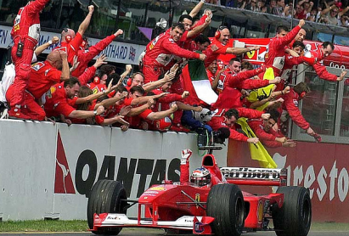
Sprint Review Meeting and Subsequent Activities
Sprint Review Meetings occur on the afternoon of the last day of a sprint
The scum team reviews each User Story and then demonstrates the functionality implemented
The scrum team discusses any user stories that were not demonstrated
The testing team presents test and quality metrics
Attendees include Product Owners, Scrum Master, Scrum Team and Testing Team members
The Sprint Review sets the stage for the Business Review meeting
Functionality demonstrated by the Scrum team is
deployed to the Model Office environment if possible
During the Business Review, business representatives
use the PAS application to experience first-hand the
functionalities demonstrated in the Sprint Review
The Business Review takes place during the week
following the Sprint Review and is facilitated by the
testing team
- 14 -

Slide 15

Sprint Retrospective Meeting and Subsequent Activities
Sprint Retrospective Meetings start on the afternoon of the
last day of a sprint
Each scrum team discusses what it wants to do more and
what it wants to do less, what it wants to start and stop
Scrum team members complete a survey about scrum behaviors
Scrum Masters publish action items and ensure they are completed
Attendees include Product Owners, Scrum Master and Scrum Team Members
Subsequent Activities
User stories that were not picked up during the Sprint are returned to the product backlog
User stories that were worked but not completed are returned to the product backlog (with Returned from Sprint = Sprint number) and repointed
Pre-sprint Review Tasks with no effort expended on them move directly to the next Sprint Backlog
Incomplete tasks for user stories that have returned to the Product Backlog also go back to the product backlog (These can be picked up when the user story comes back into a sprint)
If any hours were spent in the closed sprint, a (closed) task is
left in the Sprint backlog to represent the effort expended
Product Owners reprioritize the product backlog
- 15 -

Slide 16

Additional Considerations
Every story that will be tested by QA will have a test package available once the story is in Team Review status. At the beginning of every sprint, each developer should review the test packages associated with his or her stories. Developers should ensure that every test can be satisfied within the first two days of the sprint. If not, developers must work with BSA Design and Testing team members and Scrum Master to resolve the situation.
Developers should proactively communicate with Product Owners about any and all Exigen departures from user story expected behaviors. Variances should be documented in: - Design notes - Release notes - Clarifications - Test Packages and Acceptance Criteria should be updated
Stories should be estimated without "extra padding.” If the estimates are high or low, team credibility is negatively affected. A contingency is added to the estimate to buffer financials. Do not over-estimate the stories.
Work collaboratively within and across teams to find the most efficient way to group, code and test stories. .

Slide 17
Additional Considerations, continued
Developers should not develop off the wireframe exclusively; if there are conflicts with the user story, the user story trumps the wireframe. In the future, a clickable prototype approach will start to be utilized. The clickable prototype may not look like Exigen will display the desired functionality and should function like Exigen.
Sprints are time-boxed. Effort after the official end of a sprint is counted toward the next sprint.
Each sprint’s point commitment (Sprint Velocity Target) is based on resource allocation to the project for the first three weeks of a sprint, and reflect ramp-up time for new resources. This leaves two weeks at the end of the sprint to catch up for any unexpected dependencies and defects.
Development team members should work side by side with testers to confirm understanding of the story and any defects. If the tester is not co-located, work through the Test Manager and Defects Manager ensure understanding.

Slide 18
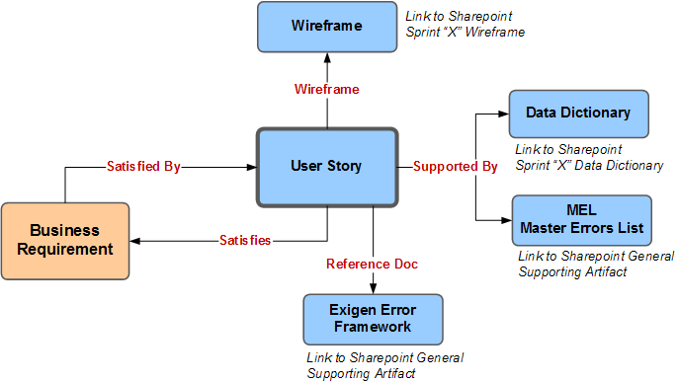
Requirements Links in RRC

Slide 19
Status Flow: User Stories in RTC Design Backlog
BSA DESIGN BACKLOG
Not Started
On Hold: Design Pending CR
On Hold: Design Pending UX
BSA Design In Progress
On Hold: Design Pending Dev Input
BSA Design Ready for Review
BSA Design In Review
On Hold: BSA Design Pending Clarification
BSA Design Review Complete
PRODUCT BACKLOG
In TA Review

Slide 20
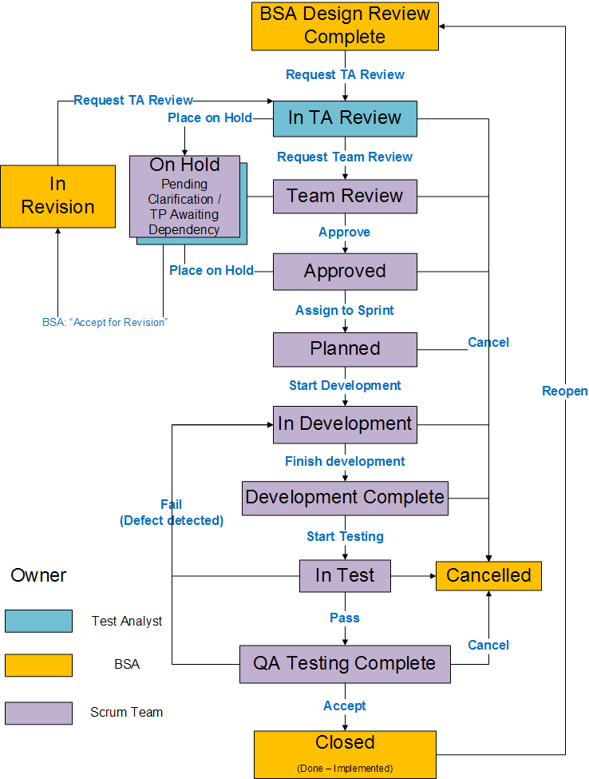
Status Flow: User Stories in RTC Product Backlog
Reminder: only Design Team members should set a user story into “In Revision” status

Slide 21
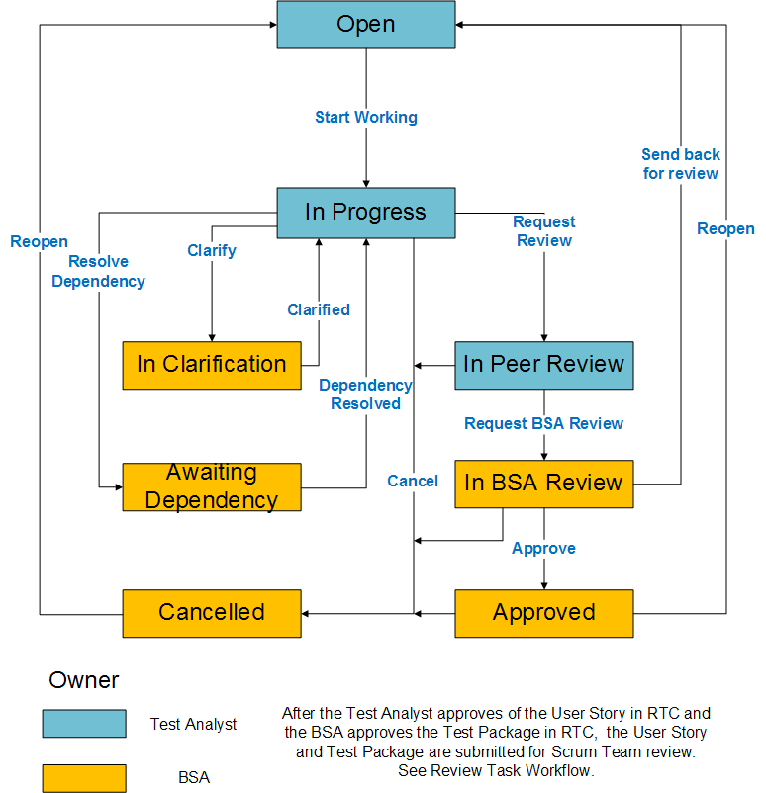
Status Flow: Test Packages in RTC

Slide 22
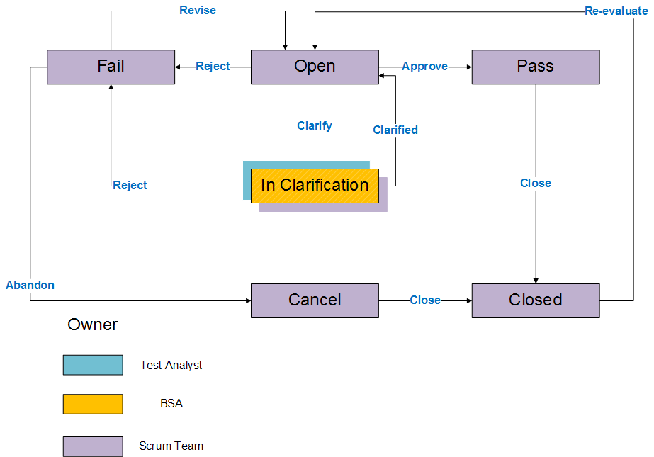
Status Flow: Review Tasks in RTC

Slide 23
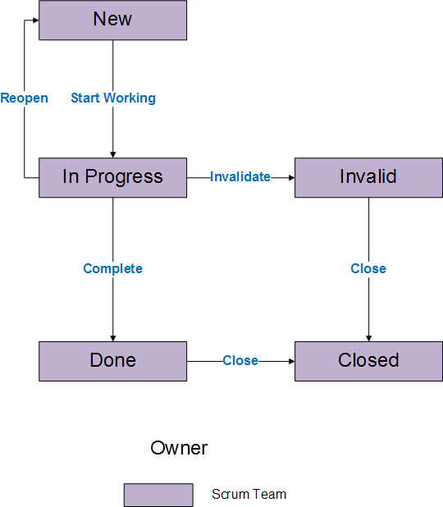
Status Flow: Implementation Tasks in RTC

Slide 24
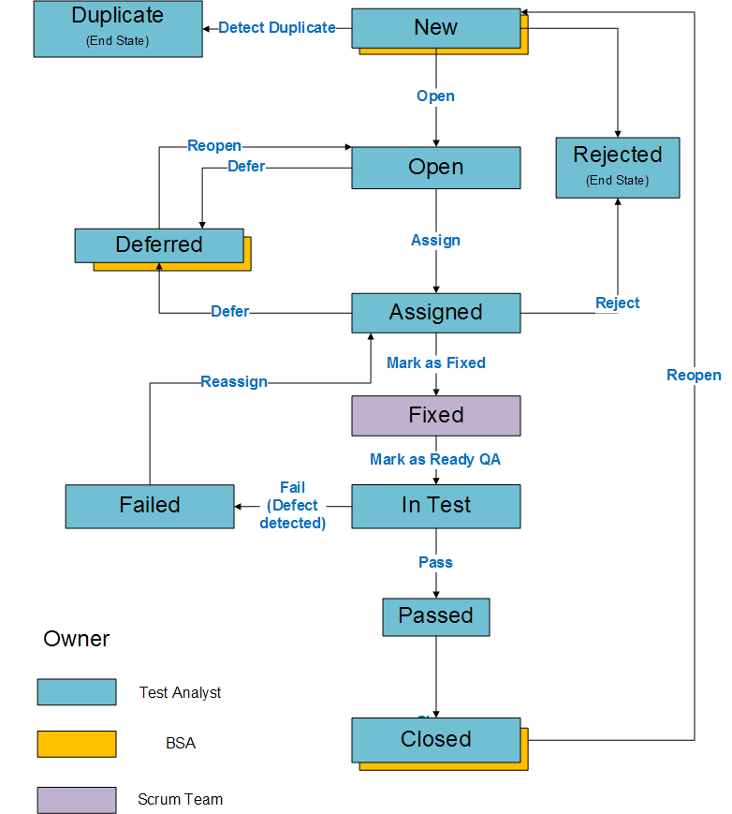
Status Flow: Defect Workflows in QC and RTC

Slide 25
Standard RTC Queries
Open assigned to me
Defects – Includes all defects, listed by newest first
Team * Backlog
Team * Total Tasks
Team * Impediments
Stories in the Product Backlog
Listed in ranked order, includes story points
Used for determining readiness of stories for inclusion in next Sprint
Stories in the Current Sprint Backlog
Listed by Status and Summary
Used to review status information for stories in the current sprint
“Build Info” – lists the actual build contents (used for release notes)
“Build Info - Planned” lists the Build Plan
Open Impediments
Open Clarifications
Aging Report – Clarifications
Aging Report – Defects
Current Sprint Total Tasks – lists all tasks by owners with time estimated and expended

Slide 26
Tool Links
SharePoint – Overall Program Site
SharePoint – Core Development Site
SharePoint – Architecture Site
RTC Eclipse Client Installation Instructions
RTC Web Client / PAS Property Dashboards
Quality Center
Property PAS Exigen training materials
Developer’s Guide
This document
WTS (Timesheets)
ProWAND (Timesheets)
AAA PassPort (Intranet site for AAA)
IT Service Catalog (Report problems, order software)
SAM Reset (Password Reset)
EKM Wiki – PAS Auto
Org Chart

Slide 27
Notes about accessing Sharepoint and other links from VMs
Links from PowerPoint decks to not work directly. You will need to cut and past links from the previous slide into your browser.
You will need to add “.ent.rt.csaa.com” to any URL when it is accessed from the VMs. The link will prompt you to enter credentials. Make sure to use your ENT credentials when prompted.
For example, instead of http://aaagateway/sites/PDR/Property/Wiki%20Pages/Home.aspx, use http://aaagateway.ent.rt.csaa.com/sites/PDR/Property/Wiki%20Pages/Home.aspx. When it prompts for credentials, use ENT\gidHere for User ID and ENT domain password.
Use the same technique for other links that do not have fully qualified path. Ex: instead of http://passport/ use http://passport.ent.rt.csaa.com/
Instant messaging does not work on the VMs.

